Slide 1
TIME SERIES MODEL-ARIMA

Slide 2
Box-Jenkins (ARIMA) Models
ARIMA models are statistical models that use lagged values of the dependent variable and/or random disturbance terms as explanatory variables.
ARIMA models rely heavily on the autocorrelation pattern in the data
ARIMA models can also be developed in the presence of seasonality in the time series. ( SARIMA- to be discussed in the next session)

Slide 3
Box-Jenkins (ARIMA) Models
ARIMA models thus essentially ignore domain theory (by ignoring “traditional” explanatory variables),
Why use them?
The use of ARIMA is appropriate when:
Little or nothing is known about the dependent variable being forecasted,
The independent variables known to be important cannot be forecasted effectively
Objective is to obtain short term forecasts

Slide 4
Box-Jenkins (ARIMA) Models
Three basic ARIMA models for a stationary time series y_{t} :
Autoregressive model of order p (AR(p))
i.e., y_{t} depends on its p previous values
(2) Moving Average model of order q (MA(q))
i.e., y_{t} depends on q previous random error terms

Slide 5
Box-Jenkins (ARIMA) Models
(3) Autoregressive-moving average model of order p and q (ARMA(p,q))
i.e., y_{t} depends on its p previous values and q previous random error terms

Slide 6
A Five-Step Modeling Procedure
Stationarity Checking and Differencing
Model Identification
Parameter Estimation
Diagnostic Checking
Forecasting

Slide 7
Step One: Stationarity Checking

Slide 8
Stationary Time Series
Time series process is called stationary if the statistical properties of the process remain unchanged over time.
i.e if Y_{t} is a time series t=1,2,3,…
E(Y_{t})= μ_{t} =μ (constant) ∀ t=1,2,…
Var(Y_{t})=σ_{t}² = σ² (constant) ∀ t=1,2…
cov(Y_{t},Y_{t-s}) depends only on s(lag),and is independent of t (time).

Slide 9
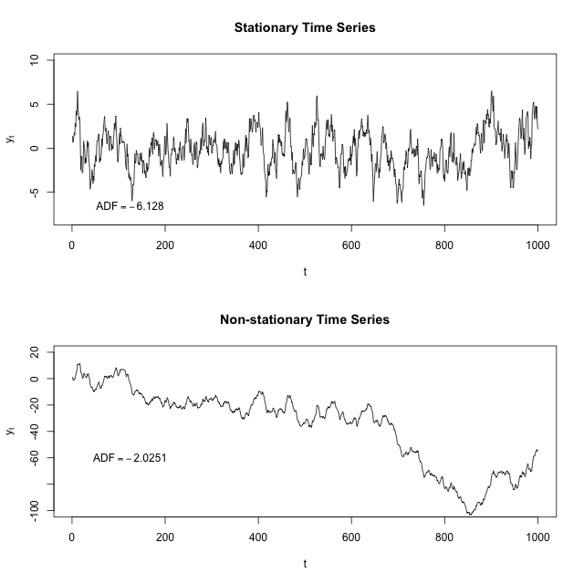
Stationary Time Series

Slide 10
Assessing Stationarity of Time Series
Stationarity of a time series can be assessed using:
Time Series Plot (Time vs. Variable)
Correlogram
Dickey-Fuller Test
Non-Stationary time series can be converted into stationary using 'differencing' .
ndiffs() function in forecast package provides number of times time series should be differenced to achieve stationarity.

Slide 11
Differencing
Differencing continues until stationarity is achieved.
The differenced series has n-1 values after taking the first-difference, n-2 values after taking the second difference, and so on.
The number of times that the original series must be differenced in order to achieve stationarity is called the order of integration, denoted by d.
In practice, it is not required to go beyond second difference.

Slide 12
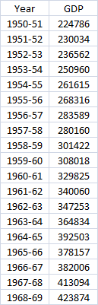
GDP Time Series Data Snapshot
This is partial data.
The data has GDP values
for 1950-51 to 2006-07

Slide 13
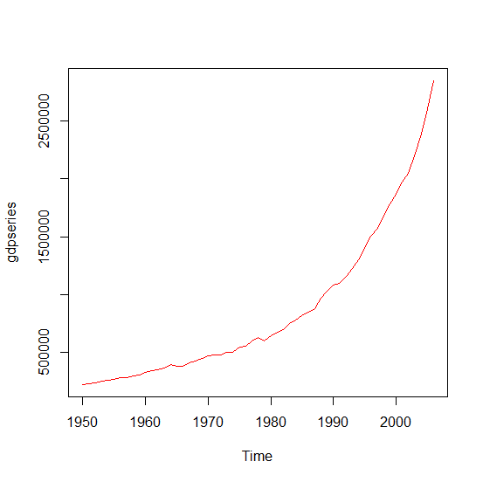
Time Series Analysis in R
Plot Time Series
Time Series Analysis in R
Plot Time Series
gdpdata<-read.csv(file.choose(),header=T)
gdpseries<-ts(gdpdata$GDP,start=1950,end=2006)
plot(gdpseries,col="red")
Clearly a non-stationary time series.

Slide 14
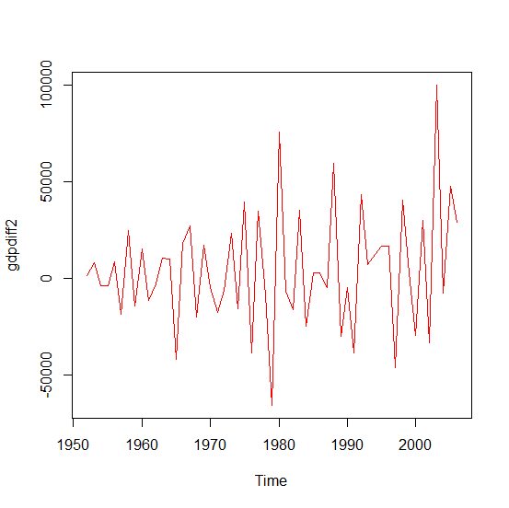
How Many Times Should Time Series Be Differenced to Make Stationary?
install.packages("forecast")
library(forecast)
ndiffs(gdpseries) # gives 2
gdpdiff2<-diff(gdpseries,differences=2)
plot(gdpdiff2,col="red")

Slide 15
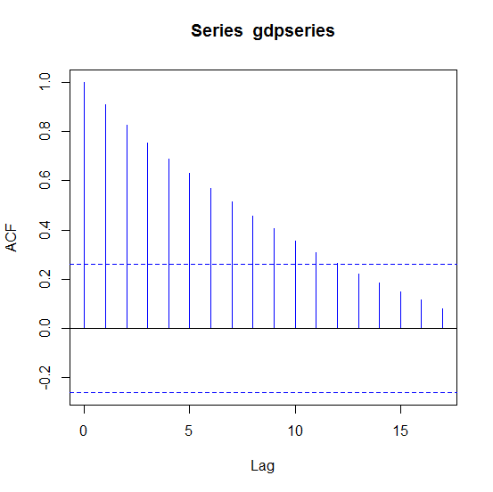
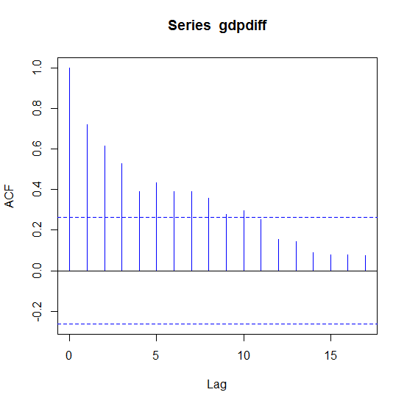
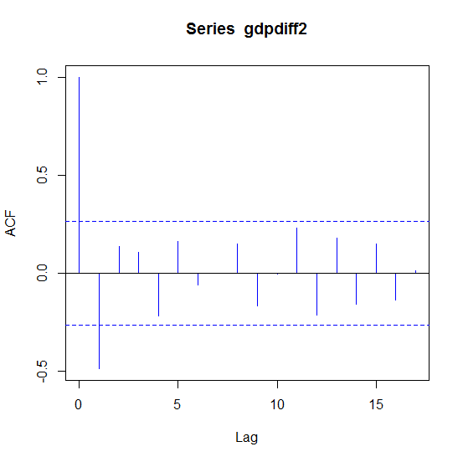
Time Series Analysis in R
Correlograms
Stationarity is achieved with second order difference

Slide 16
Time Series Analysis in R
Dickey Fuller Test…
library(urca)
df<-ur.df(gdpseries,lag=0)
summary(df)
Value of test-statistic is: 19.2745
Critical values for test statistics:
1pct 5pct 10pct
tau1 -2.6 -1.95 -1.61
Inference: Time series is non-stationary. Value of test statistic is greater than 5% critical value.

Slide 17
Time Series Analysis in R
Dickey Fuller Test
library(urca)
df<-ur.df(gdpdiff2,lag=0)
summary(df)
Value of test-statistic is: -11.9083
Critical values for test statistics:
1pct 5pct 10pct
tau1 -2.6 -1.95 -1.61
Inference: Time series is stationary. Value of test statistic is less than
5% critical value.

Slide 18
Step Two: Model Identification

Slide 19
Model Identification
When the data are confirmed stationary, one may proceed to tentative identification of models through visual inspection of correlogram and partial correlogram.
Some guidelines exist to identify models using correlogram and partial correlogram.
In practice, it is not always easy to identify model using visualization.
However, R /Python has built in function to identify best model
which can be used for forecasting.

Slide 20
Summary of the Behaviour of Autocorrelation and Partial Autocorrelation Functions
# The meaning of dies down is “gradual decrease”

Slide 21
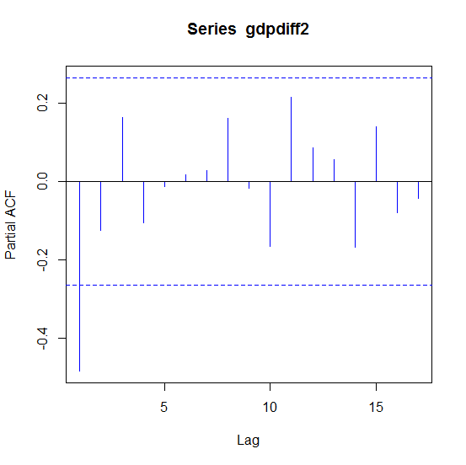
Model Identification
Indicative Statistical Model – ARIMA(1,2,1)
Where,
number of autoregressive terms= 1
order of differencing= 2
number of moving average terms= 1

Slide 22
Step Three: Parameter Estimation

Slide 23
Parameter Estimation
The method of least squares can be used. However, for models involving an MA component MLE is used.
Given n observations y₁, y₂, …, y_{n}, the likelihood function L is defined to be the probability of obtaining the data actually observed.
The maximum likelihood estimators (M.L.E.) are those value of the parameters for which the data actually observed are most likely, that is, the values that maximize the likelihood function L.

Slide 24
Time Series Analysis in R
ARIMA Model in R
gdpmodel<-arima(gdpseries,order=c(1,2,1))
coef(gdpmodel)
> coef(gdpmodel)
ar1 ma1
-0.3654655 -0.1202087
AIC(gdpmodel)
> AIC(gdpmodel)
[1] 1285.361
Smaller the AIC value, better is the model. We need to try out various
combinations of AR and MA terms to arrive at final model.

Slide 25
Time Series Analysis in R
ARIMA Model in R…
library(forecast)
gdpmodel<-auto.arima(gdpseries,d=2,max.p=1,max.q=1,trace=TRUE,ic="aic")
> auto.arima(gdpseries,d=2,max.p=1,max.q=1,trace=TRUE,ic="aic")
ARIMA(1,2,1) : 1285.361
ARIMA(0,2,0) : 1294.497
ARIMA(1,2,0) : 1283.644
ARIMA(0,2,1) : 1285.212
Best model: ARIMA(1,2,0)

Slide 26
Time Series Analysis in R
ARIMA Model in R…
coef(gdpmodel)
> coef(gdpmodel)
ar1
-0.4555743
AIC(gdpmodel)
> AIC(gdpmodel)
[1] 1283.644

Slide 27
Brief Note Model Selection Criteria
Akaike Information Criterion (AIC)
AIC = -2 ln(L) + 2k
Schwartz Bayesian Criterion (SBC)
SBC = -2 ln(L) + k ln(n)
where L = likelihood function
k = number of parameters to be estimated,
n = number of observations.
Ideally, the AIC and SBC should be as small as possible

Slide 28
Step Four: Diagnostic Checking

Slide 29
Residual Analysis
If an ARMA(p,q) model is an adequate representation of the data generating process, then the residuals should be 'White Noise'.
A white noise process is a serially uncorrelated, zero-mean, constant and finite variance process.
Under the null hypothesis that y_{t} is a white noise process, the Box-Pierce Q-statistic (based on autocorrelations upto lag m and T observations in a time series)
for large T.
Another closely connected statistical test is Ljung-Box test.

Slide 30
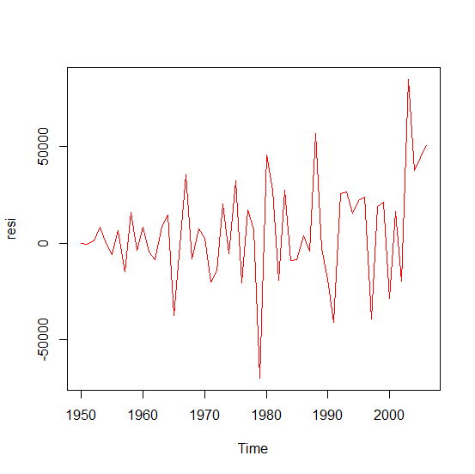
Time Series Analysis in R
ARIMA Model in R…
resi<-residuals(gdpmodel)
Box.test(resi)
plot(resi,col="red")
Box-Pierce test
data: resi
X-squared = 0.5391, df = 1, p-value = 0.4628
Do not reject Ho.
Errors follow white noise process.

Slide 31
Step Five: Forecasting

Slide 32
Time Series Analysis in R
ARIMA Model in R…
predict(gdpmodel,n.ahead=3)
Time Series:
Start = 2007
End = 2009
Frequency = 1
[1] 3078683 3315176 3548951
************************************************************************************

Slide 33
THANK YOU!!

